Slide 1

FAKE NEWS DETECTION USING NLP
SRM INSTITUTE OF SCIENCE AND TECHNOLOGY
SCHOOL OF COMPUTING
DEPARTMENT OF COMPUTING TECHNOLOGIES
18CSP107L - MINOR PROJECT
Batch ID: 198
Student 1 Reg. No: RA1911003010072
Student 1 Name: P.S.A.BHASKAR REDDY
Student 2 Reg. No: RA1911003010113
Student 2 Name: GNANESWAR REDDY.M
Guide name: Dr.R.S.PONMAGAL
Designation: ASSOCIATE PROFESSOR Department: CTECH

Slide 2
Table of contents
1. | PROJECT TITLE | 1
2. | ABSTRACT | 3 - 4
3. | PROBLEM STATEMENT & OBJECTIVES | 5 - 6
4. | PROPOSED METHODOLOGY | 7 - 14
5. | ARCHITECTURE/BLOCK DIAGRAM | 15 - 16
6. | MODULE DESCRIPTION AND IMPLEMENTATION | 17 - 19
7. | INTERMEDIATE RESULTS & DISCUSSION | 20 - 27
8 | OUTPUT SCREENSHOTS | 28 - 33
9. | REFERENCES | 34 - 35

Slide 3
Abstract
To detect whether the news is fake or real, model must be build using various techniques.We are using Natural Language Processing.
In our project since it is concerned with building machines that can easily understand and respond to the text or voice data the same way humans do.
With Natural Language Processing, machines can even perform tasks on spoken or written text.The Python programming provides a wide range of libraries and tools for various NLP tasks.
Natural Language Toolkit is the open-source collection of libraries, programs, and resources for building NLP programs.

Slide 4
The applications of natural language processing are speech recognition, sentiment analysis, question/answer systems, chatbots, Etc.
After data pre-processing vectorization can be done to the pre-processed data for converting the text into numerical representation.
We have used translater to detect whether the news is real or fake when the data is given in any language.
This is how fake news detection can be done using artificial intelligence to save innocent people from the fake news propagators and spammers.

Slide 5
Problem Statement
The goal of this project is to make a machine learning model that is able to classify the given news is real or fake.

Slide 6
Objective
To stop spreading this fake news and to rescue innocent people from fake news propagators and spammers detection of fake news at an early stage is very essential.
There are various techniques exists to detect fake news, among them natural language processing is one of the techniques which works effectively and efficiently.
The required step that is being followed to implement an application are as follows: (1) propose a framework of online fake news detection (2) In this project a feature selection algorithm is also a result of natural language analysis. (3) collecting a dataset, we have used IFND dataset. (4) we develop a fake news detection application.

Slide 7
Methodology
Data pre-processing is the first and crucial step while building the machine learning models since it concerned with preparing the raw data and making it suitable for machine learning model.
The Natural Language Toolkit includes libraries for NLP tasks such as stemming, lemmatization, tokenization(methods that are used for breaking sentences into tokens and trimming words) etc.
After data pre-processing vectorization can be done to the pre-processed data for converting the text into numerical representation.
The three methods that are involved in data pre-processing are:
1. Tokenisation
2. Lemmatization
3. Stemming
4. Stop words

Slide 8
Tokenization:
Tokenization is the process of breaking down the natural language text data into chunks of information I.e., smaller units called as tokens. These tokens helps in understanding and developing the model for the Natural Language Processing.
It is the basic and crucial step in natural language processing. It further helps in interpreting the meaning of the given text by analyzing the sequence of the words in the given data.
Tokenization is classified into three types- word, character and n-gram characters tokenization. We are using in our fake news detection project.
Tokenization is a part in NLP
Tokenization
is
a
part
in
NLP

Slide 9
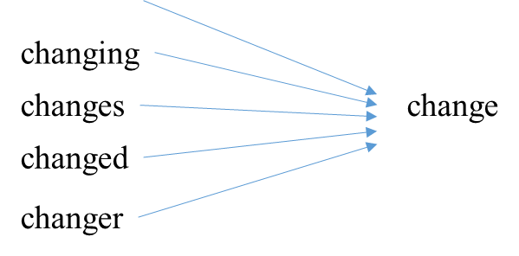
Lemmatization:
Lemmatization is the technique which is used to reduce the tokens into normalized form i.e., root dictionary form. This technique takes into consideration of the morphological analysis of the words to convert the words into normalized form.
Lemmatization mainly focus on the context in which the word is being used.
Lemmatization techniques are used by the search engines and chatbots to analyze the meaning behind the words.
change

Slide 10
Stop words:
Stop words are used to eliminate the unimportant words, allowing the applications to focus on the important words instead. The stop words are not necessary in our project because they has no scope in training or testing the data.
This method can be done by maintaining a list of stop words and preventing all the stop words from analyzed.
The necessary module for importing the stopwords is nltk.corpus. From nltk.corpus stopwords are imported.
Some of the known stop words are given below: ourselves, hers, between, yourself, but, again, there, about, once, during, out, very, having, with, they, own, an, be, some, for, do, its, yours, such, into, of, most, itself, other, off, is, s, am, or, who, as, from, him, each, the, themselves, until, below, are, we, ‘these, your, his, through, don, nor, me, were, her, more, himself, this, down, should, our, their, while, above, both, up, to, ours, had, she, all, no, when, at, any, before, them, same, and, been, have, in, will, on, does, yourselves, then, that, because, what.
Tokenization is a part in NLP
Tokenization
is
a
part
in
NLP
Stop Words

Slide 11
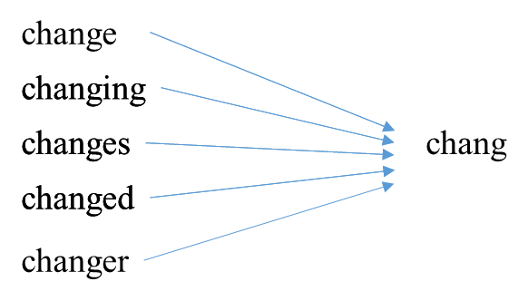
Stemming:
Stemming is the technique of reducing the word to its word stem i.e., word base. Stemming is basically removing the suffix from a word and reduce it to its root word. This technique uses the stem of the word.
Stemming techniques are used by the search engines and chatbots to analyze the meaning behind the words to produce the better results.
The stemming will be applied to the dataset by creating object to the porter stemmer class.

Slide 12
There are plenty of ways to perform vectorization. Depending on the use-case and the model, any one of them might be able to do the required task.
VECTORIZATION TECHNIQUES:
1.Bag of Words: The bag of words approach can be executed with the help of the CountVetorizer module ,which is imported from the sklearn package.
2. TF-IDF: In the case of TF-IDF technique the performance will be high when compared with the bad of words. It consists of two terms TF and IDF. TF stands for term frequency and the IDF stands for the Inverse Document Frequency.

Slide 13
Naive bayes
Machine learning models are used to predict the correct label for the given test data. So, supervised learning algorithms such as Naïve Bayes algorithm is Used.
Naive bayes classifiers are a collection of classification algorithms based on Bayes Theorem. These classifiers mainly used for text classification and text analysis machine learning problems.
The principle of naïve bayes algorithm is every pair of features being classified is independent of each other.
Naive bayes algorithm is family of algorithms where all of them share a common principle.

Slide 14
Naive bayes
However, the assumptions made by Naive Bayes are not generally correct in the real-world situations. Due to its independence assumption, it is called as naive i.e., because it assumes something that might not be true.
The naive bayes classifier converts the collection of text documents into a matrix of token during implementation.
Ultimately, the naive bayes classifier predicts the labels of the test data at the end of the code execution.
The accuracy of Naive Bayes Classifier is comparatively very high than any other machine learning algorithms for the text classification problems.

Slide 15
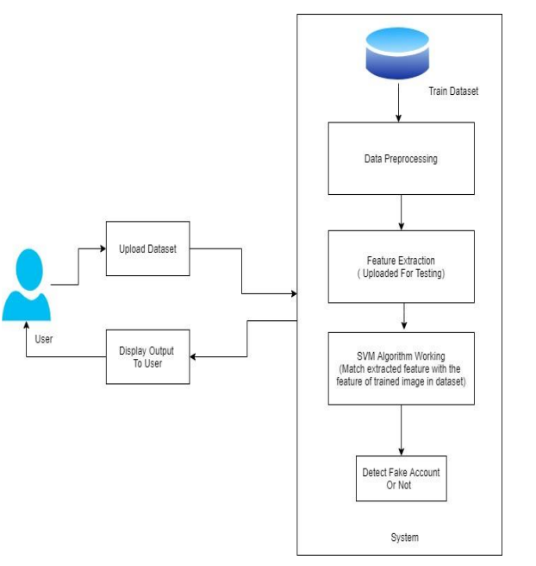
Architecture Diagram

Slide 16
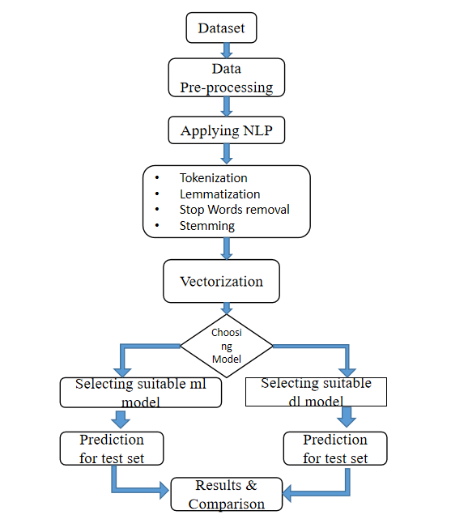
Data Flow Diagram

Slide 17
Collecting Dataset
“IFND Dataset” is a large-scale dataset of . This dataset contains news statements, category(government, violence, covid etc), label(real or fake).
This IFND dataset covers only national(India wide) news. It doesn’t cover international news. This IFND dataset was collected only from real-world sources. The real and fake news were collected from different reliable fact-checking websites.
This data set contains only two type of news fake and real and it contains seven columns. But we will be using only two columns those are news statement and label.
There are around 38,000 news statements in this data set for training and testing.

Slide 18
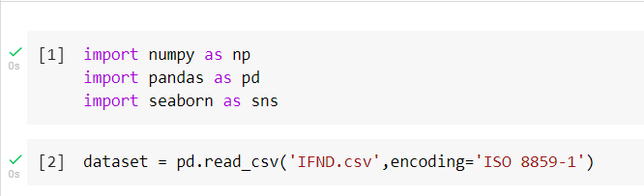
Importing libraries and modules
import numpy as np
import pandas as pd
import seaborn as sn
from googletrans import Translator
from sklearn.feature_extraction.text import CountVectorizer
from sklearn.model_selection import train_test_split
from sklearn.naive_bayes import MultinomialNB
from sklearn.metrics import confusion_matrix,accuracy_score
from sklearn.metrics import confusion_matrix,accuracy_score
import nltk

Slide 19
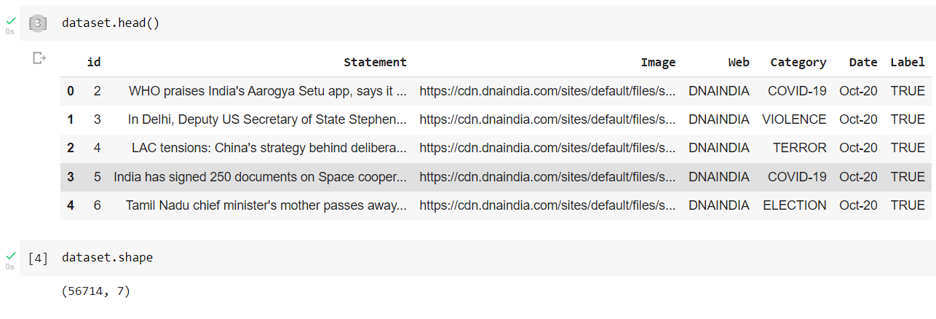
Checking Dataset Lables

Slide 20
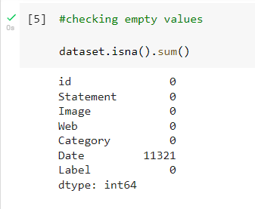
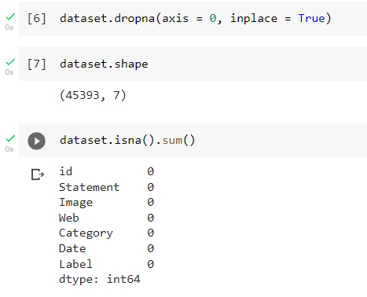
Checking Empty Values

Slide 21
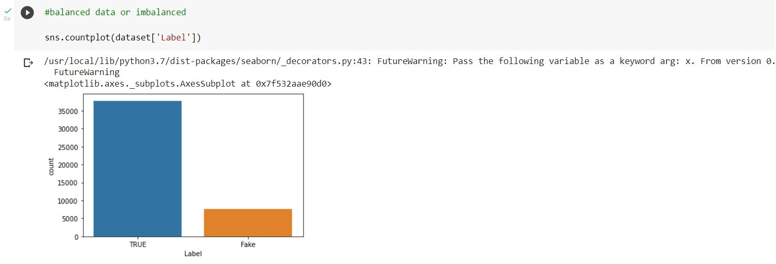
Checking The Data

Slide 22
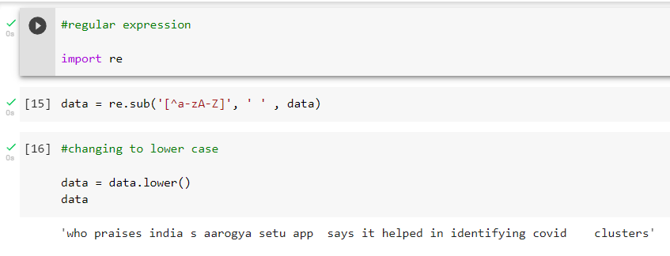
Importing Regular Expression

Slide 23
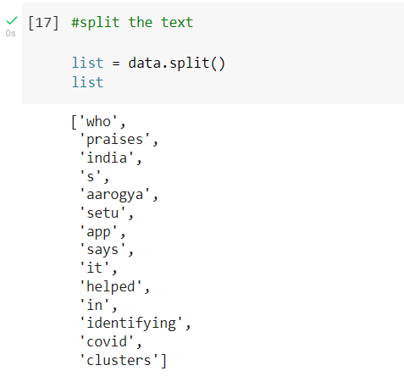
Splitting The Data

Slide 24
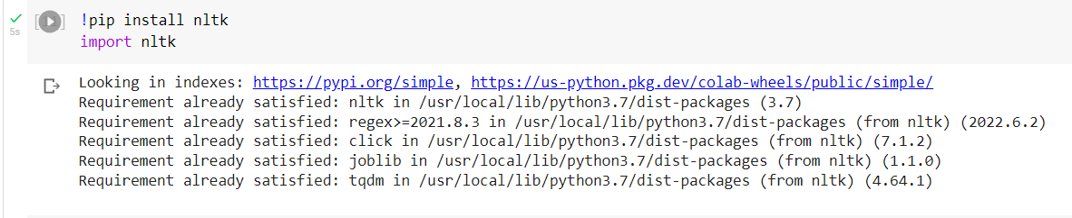
Installing NLP Toolkit

Slide 25
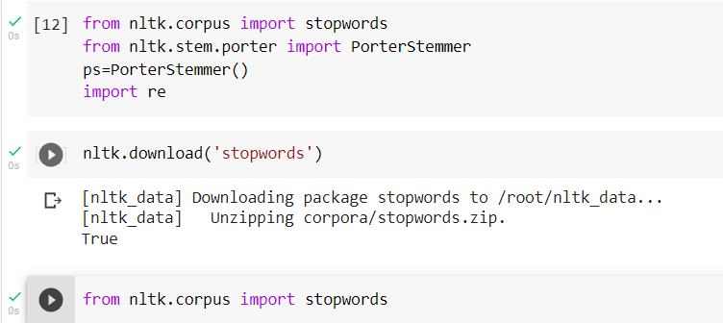
Importing Stopwords & Removing them

Slide 26
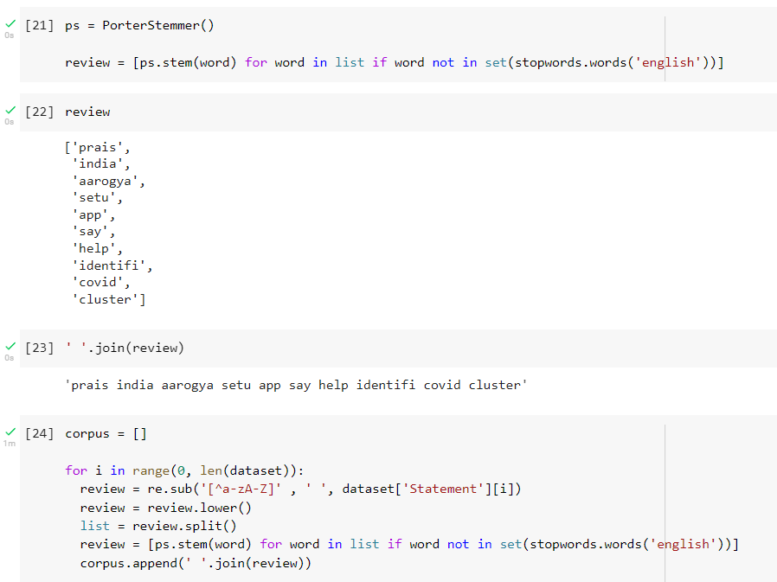
Creating A For Loop

Slide 27
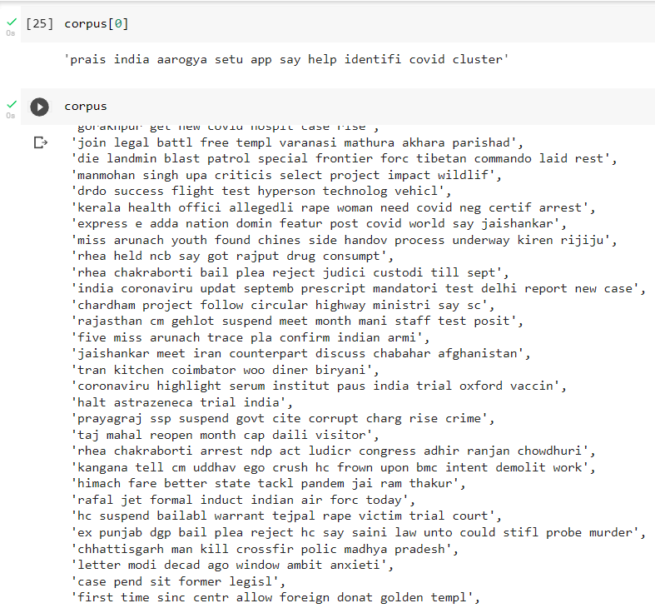
Creating A For Loop

Slide 28
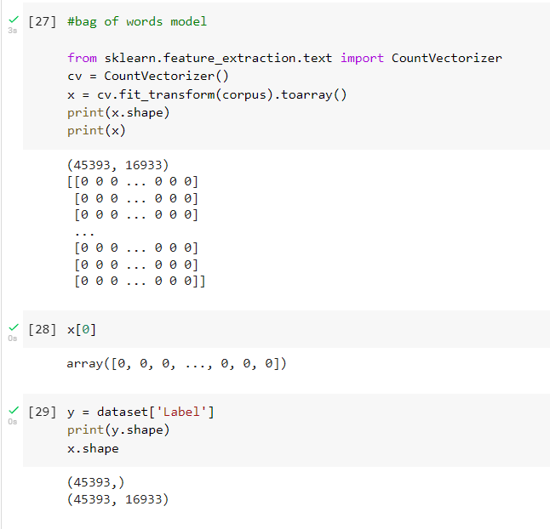
Bag Of Words Model

Slide 29
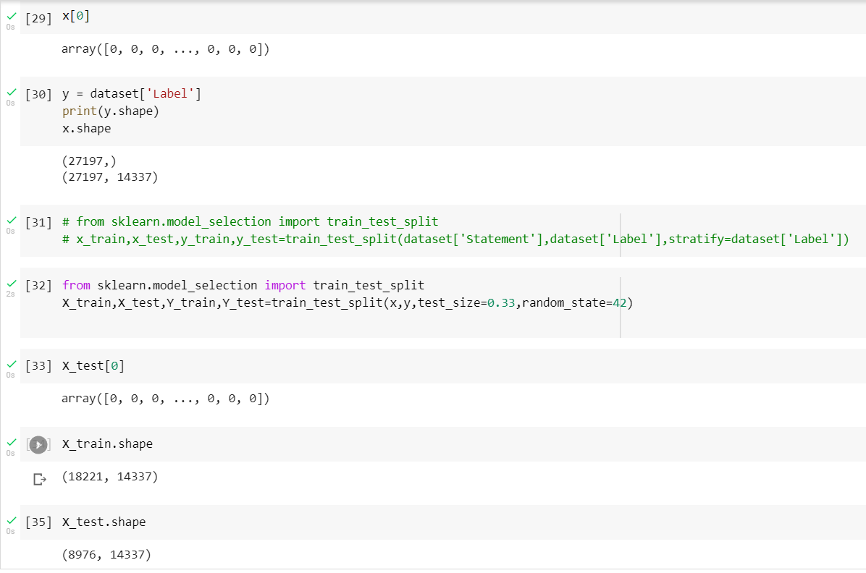
Training & Testing The Dataset

Slide 30
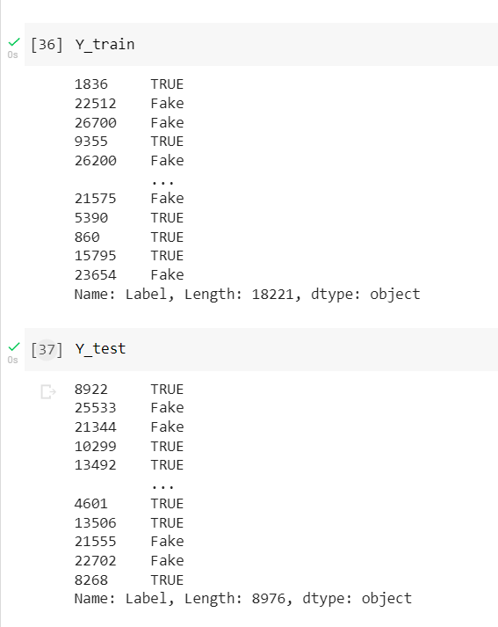
Training & Testing The Dataset

Slide 31
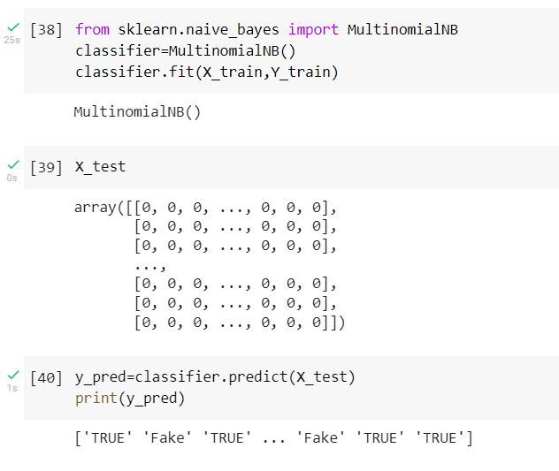
Naive Bayes Classifier

Slide 32
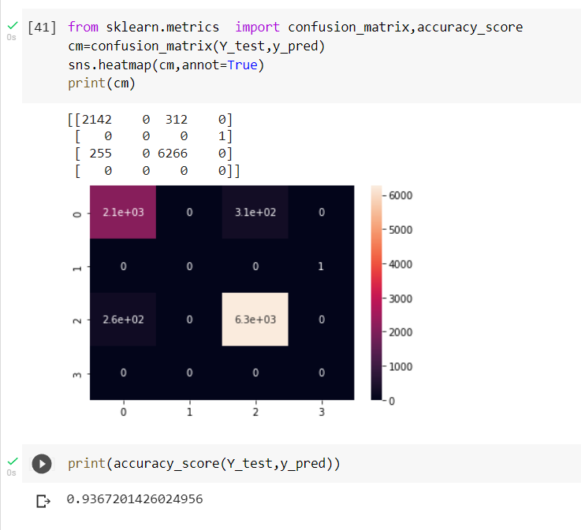
Accuracy_Score

Slide 33
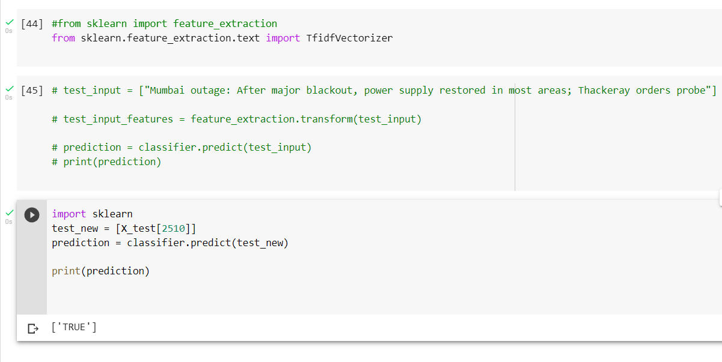
Testing For Examples

Slide 34
References
[1]. Meesad, P. Thai Fake News Detection Based on Information Retrieval, Natural Language Processing and Machine Learning. SN COMPUT. SCI. 2, 425 (2021).
[2]. Uma Sharma, Sidarth Saran, Shankar M. Patil, 2021, Fake News Detection using Machine Learning Algorithms, INTERNATIONAL JOURNAL OF ENGINEERING RESEARCH & TECHNOLOGY (IJERT) NTASU – 2020.
[3]. Sakeena M Sirajudeen, Nur Fataihah A Azmi, Adamul Abubakar, Online fake news detection algorithm, journal of theorical and Applied information Technology, 2017.
[4].J. C. S. Reis, A. Correia, F. Murai, A. Veloso and F. Benevenuto, "Supervised Learning for Fake News Detection," in IEEE Intelligent Systems, vol. 34, no. 2, pp. 76-81, March-April 2019.

Slide 35
[5]. Jamal Abdul Nasir, Osama Subhani Khan, Iraklis Varlamis, Fake news detection: A hybrid CNN-RNN based deep learning approach, International Journal of Information Management Data Insights, Volume 1, Issue 1, 2021.
[6]. Z. Shahbazi and Y. -C. Byun, "Fake Media Detection Based on Natural Language Processing and Blockchain Approaches," in IEEE Access, vol. 9, pp. 128442-128453, 2021.
[7]. K. Shu, S. Wang and H. Liu, "Understanding User Profiles on Social Media for Fake News Detection," 2018 IEEE Conference on Multimedia Information Processing and Retrieval (MIPR), 2018, pp. 430-435.
[8]. Ahmad, T.; Faisal, M.S.; Rizwan, A.; Alkanhel, R.; Khan, P.W.; Muthanna, A. Efficient Fake News Detection Mechanism Using Enhanced Deep Learning Model. Appl. Sci. 2022.

